Slide 1
Journée MIAPPE
Minimum Information About Plant Phenotyping Experiments
Matin (9h30 - 11h45)
Après midi (13h00- 16h30)
Atelier: Ontologies en détails, Annotation et mise en forme de jeux de données (Template Excel)
MIAPPE : les détails manquants
Quelques examples en plus
HANDS ON !

Slide 2
MIAPPE overview

Slide 3
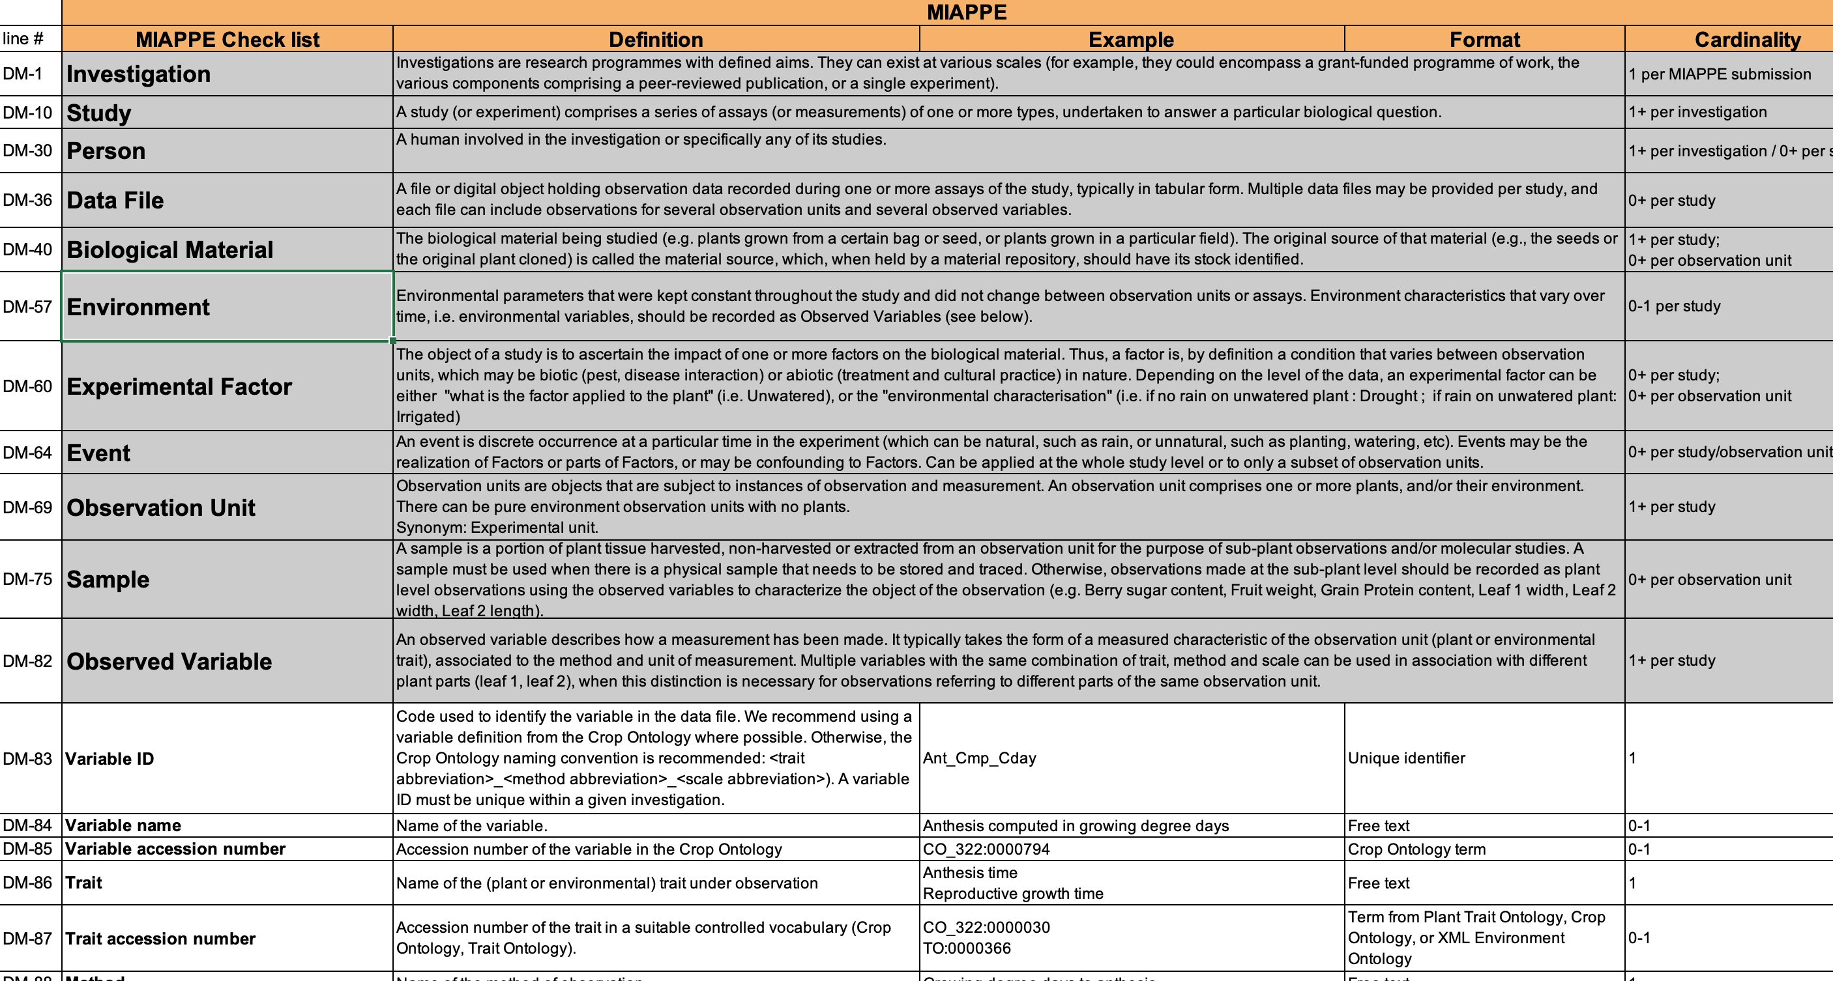
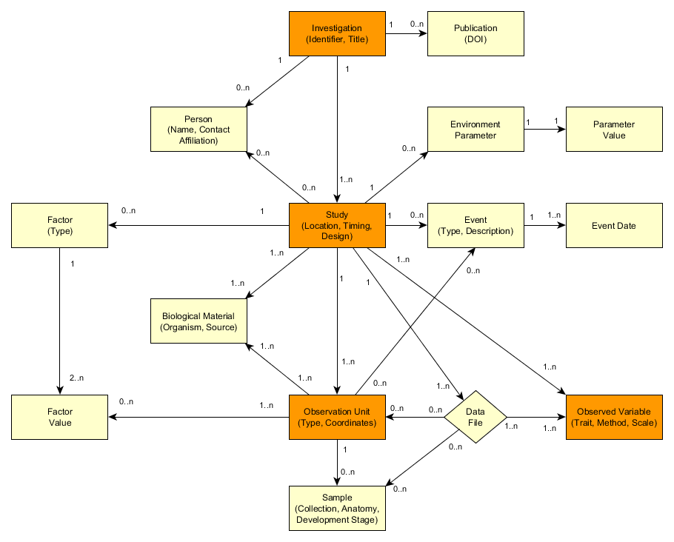
MIAPPE Specifications https://github.com/MIAPPE/MIAPPE/tree/master/MIAPPE_Checklist-Data-Model-v1.1
Specification table
Sections
Metadata Fields
Linked and organized

Slide 4
Capturing important information about phenotyping experiments using the MIAPPE standard
Two examples to illustrate how to capture important information about the phenotyping experiments:
MAIZE [1]
Millet et al. 2019 (https://doi.org/10.15454/IASSTN): A multi-site experiment in a network of European fields for assessing the maize yield response to environmental scenarios
POPLAR [2]
Monclus et al. 2012 (http://dx.doi.org/10.1186/1471-2229-12-173): Integrating genome annotation and QTL position to identify candidate genes for productivity, architecture and water-use efficiency in Populus spp

Slide 5
Millet et al 2019 [1] - Material&methods section on phenotyping experiments
A panel of 256 maize hybrids was grown with two water regimes (irrigated or rainfed).
Location: seven fields in 2012 and 2013, plus one site in Chile in 2013
This resulted in 29 experiments defined as the combination of one year, one site and one water regime, with two and three repetitions for rainfed and irrigated treatments, respectively.
A detailed environmental characterisation was carried out, with hourly records of micrometeorological data and soil water status, and associated with precise measurement of phenology.
« grain.yield»: yiel adjusted at 15% grain moisture, in ton per hectare (t ha-1). «grain.number»: number of grain per square meter. «grain.weight»: individual grain weight (mg). «anthesis»: male flowering (pollen shed), in thermal time cumulated since emergence (d20°C). «silking»: female flowering (silking emergence), in thermal time cumulated since emergence (d20°C). «plant.height»: plant height, from ground level to the base of the flag leaf (highest) leaf (cm). «tassel.height»: plant height including tassel, from ground level to the highest point of the tassel (cm). «ear.height»: ear insertion height, from ground level to ligule of the highest ear leaf (cm).

Slide 6
Monclus et al 2012 [2] - Material&methods section on phenotyping experiments
3 Field trial established in April 2003 located in France (Ardon, 47°49’41''N, 1°54’39''E, 110 m),Italy Cavallermaggiore ((44° 43' 0'' N) , (7° 41' 0'' E)), UK Headley ((51° 7' 0'' N) , (-1° 10' 0'' W) )
The biological material consisted of a cloned 336 F1 progeny from an interspecific cross between the female Populus deltoides (Bartr. Ex Marsh.) ‘73028-62’ from Illinois and the male P. trichocarpa (Torr. and Gray) ’101-74’ from Washington State.
The trial was established from 25 cm- homogenous hardwood cuttings planted at a plant density of 6670 trees per ha. The trial was and consisted in 6 randomized complete blocks where each F1 genotype and each parent was represented by one replicate.
Circumference and stem height were measured at the end of the first (winter 2003–2004) and second (winter 2004–2005) as described in Dillen et al. Forest Ecol Manag. 2007, 252 (1–3): 12-23). Growth increment in height and circumference during the second growing season were calculated.
Leaf traits where measured in 2003: one fully illuminated mature leaf was collected on each tree according to Monclus et al. http://doi.org/10.1111/j.1469-8137.2005.01407.x ). Six calibrated discs of lamina were cut from this leaf, dried at 50 °C during 48 °C and weighed, and specific leaf area (SLA, cm² g⁻¹) was computed. Leaf discs were ground to fine powder for analysis of leaf carbon isotope composition (δ¹³C), carbon (C_{M}) and nitrogen (N_{M}) contents. One-milligram subsamples of ground material were used for measuring the CO₂ produced by combustion and its ¹³CO₂/¹²CO₂ ratio by a continuous flux isotope ratio mass spectrometer. The discrimination between atmospheric CO₂ and plant material was calculated.

Slide 7
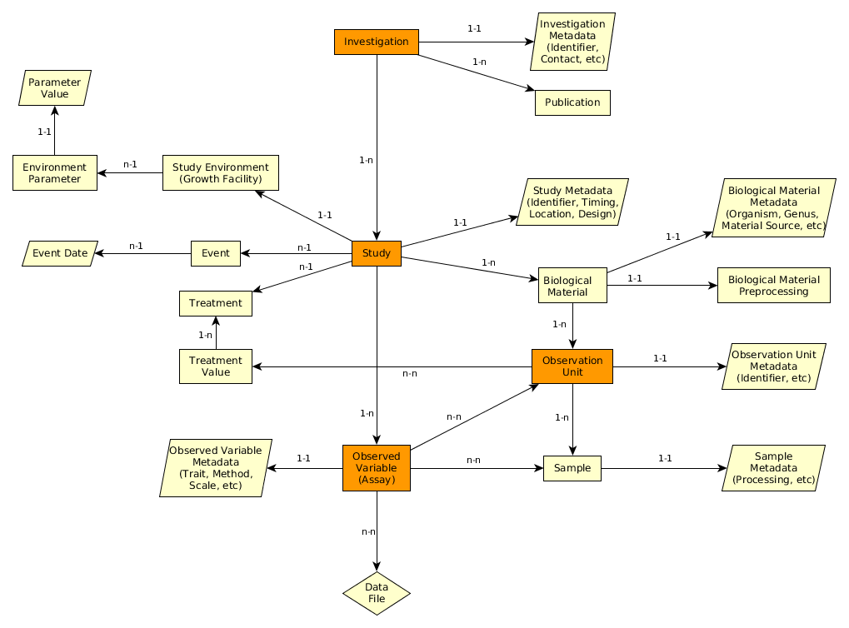
MIAPPE V1.1 Overview – The (ISA) backbone
Investigation
Study
Assay
(Observed variable)

Slide 8
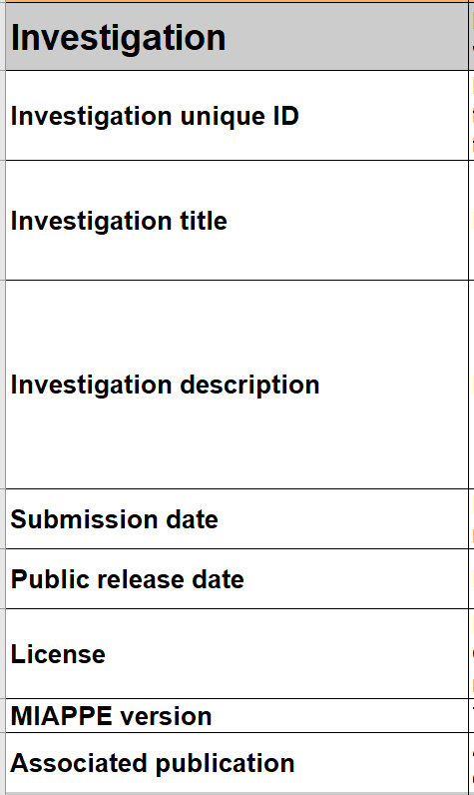
MIAPPE main sections – Investigation
Investigations are research programmes with defined aims.
They can exist at various scales: e.g. grant-funded programme of work with various published components; a single experiment.
=> One investigation holds one to many studies.
Metadata: similar to the information required for the deposition of a dataset in an archive attached to a DOI
=> title, description, associated publications/people, ...
Examples:
MAIZE [1]: the whole set of multilocal and pluriannual phenotyping experiments constitute the investigation
POPLAR [2]: the whole set of multilocal measurements over three years constitute the investigation

Slide 9
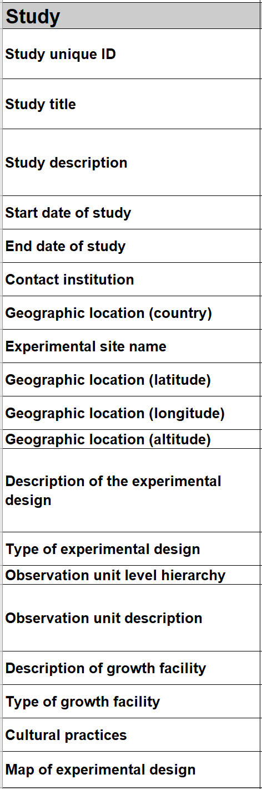
MIAPPE main sections – Study
A "study" (or experiment)
Comprises a series of assays (or measurements) undertaken to answer a particular biological question
One study = one location
Metadata: all the informations describing the experiment as a whole
=> timing, location, statistical design, cultural pratices, etc...
Examples:
MAIZE [1] : 29 studies => 2 years x 7 locations x 2 treatments (Gaillac 2012 rain, Gaillac 2013 watered, …)
POPLAR [2] : 6 studies => 3 locations over 2 years (Ardon_2003-2004, Ardon_2004-2005)

Slide 10
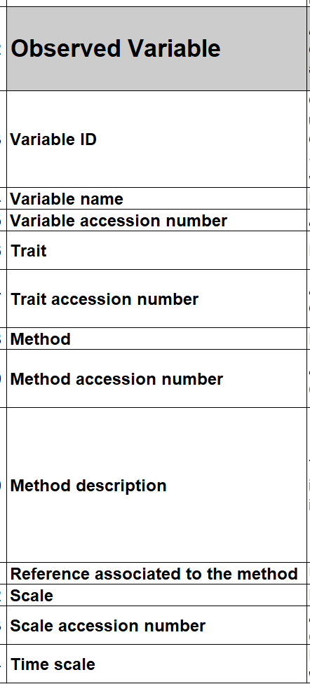
MIAPPE main sections – Observed Variable (Assay)
An Observed Variable (assay) corresponds to a specific measurement. The assay targets a trait of interest (phenotype or environment) and the measurement conducted is associated with a method and a scale
Metadata: the mandatory metadata of the Crop Ontology Trait Dictionary (trait, method and scale)

Slide 11
Crop Ontology Trait Dictionary Standard
Variable = trait + method + scale
The phenotypic observation
Trial | Genotype | CIR | HT | SUR
Domaine de Valcros | 6579 | 600 | 17 | 1
Domaine de Valcros | 6580 | 482 | 14 | 1
Variable | Variable ID
 | Variable name
 | Variable synonyms
 | Context of use
 | Growth stage
 | Variable status
 | Variable Xref
 | Institution
 | Scientist
 | Date
 | Language
 | Crop

Slide 12
Crop Ontology Trait Dictionary Standard
Variable = trait + method + scale
What is the studied character?
Trial | Genotype | CIR | HT | SUR
Domaine de Valcros | 6579 | 600 | 17 | 1
Domaine de Valcros | 6580 | 482 | 14 | 1
Trait | Trait ID
 | Trait
 | Trait class
 | Trait description
 | Trait synonyms
 | Main trait abbreviation
 | Alternative trait abbreviations
 | Entity
 | Attribute
 | Trait status
 | Trait Xref
Circumference of the tree
Total height of the tree
Survival state of the tree

Slide 13
Crop Ontology Trait Dictionary Standard
Variable = trait + method + scale
How is it observed?
Trial | Genotype | CIR | HT | SUR
Domaine de Valcros | 6579 | 600 | 17 | 1
Domaine de Valcros | 6580 | 482 | 14 | 1
Method | Method ID
 | Method
 | Method class
 | Method description
 | Formula
 | Method reference
Measured at breast height with a graduated ribbon
Measured from soil to crown with a pole or a clinometer
Visual assessment with a reference scoring scale

Slide 14
Crop Ontology Trait Dictionary Standard
Variable = trait + method + scale
How is it expressed (unit or scale)?
Trial | Genotype | CIR | HT | SUR
Domaine de Valcros | 6579 | 600 | 17 | 1
Domaine de Valcros | 6580 | 482 | 14 | 1
Scale | Scale ID
 | Scale name
 | Scale class
 | Decimal places
 | Lower limit
 | Upper limit
 | Scale Xref
 | Category 1
 | Category 2
 | …
 | Category n
cm
mm
0 = Alive
1 = Dead
2 = Doubtful

Slide 15
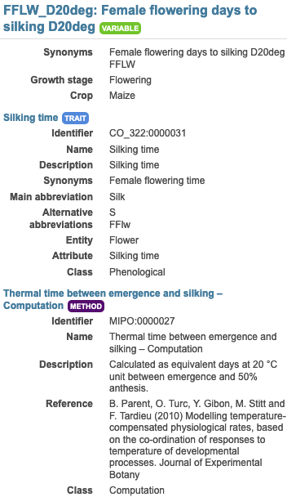
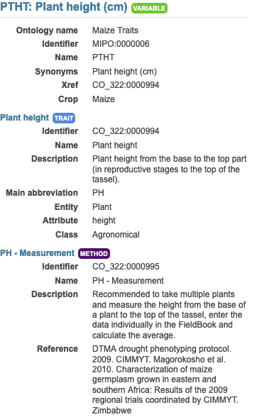
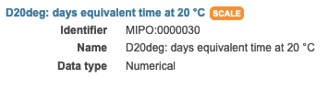
MIAPPE main sections – Observed Variable (Assay)
Example:
In each study of MAIZE [1] three measurements are made:
Plant level: 20 variables
Genotype/Study level: 19 variable both phenotype and environment
Plot level: 9 variables
For instance
Female flowering days to silking D20deg
Plant height (cm)

Slide 16
MIAPPE V1.1 Overview – The biological material
Investigation
Study
Biological material
Observation Unit
Assay
(Observed variable)
Sample

Slide 17
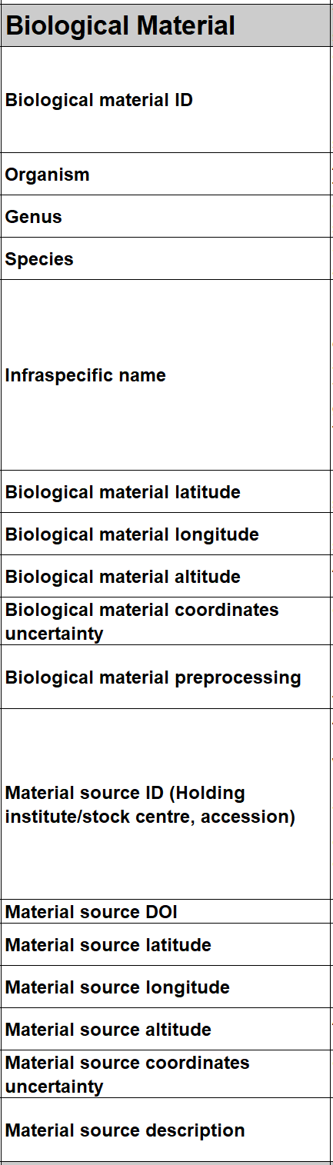
MIAPPE main sections – Biological material
Biological material identify the biological material being studied and its source (if provided originally by a stock center for instance).
=> This section is crucial for integrating phenotyping data with genomic or genetic data
Metadata:
Minimal fields from Multicrop Passport Descriptor (MCPD) standard
GPS location for forest tree / in situ material provenance

Slide 18
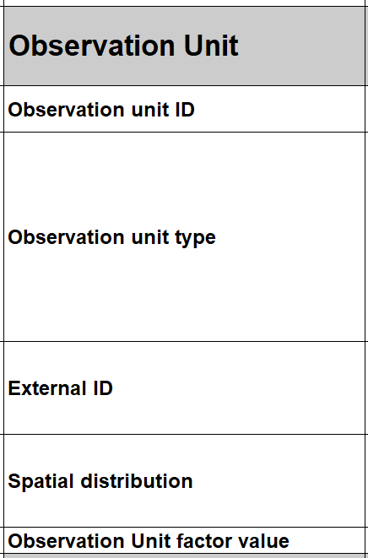
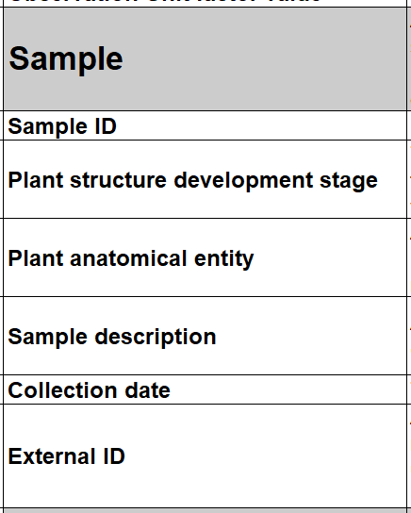
MIAPPE main sections – Observation Unit & Samples
Observation units are the objects in the study about which observations are made, and which may take different treatment values. They typically correspond to one or more individual plants. They can also be used for environmental variables.
Metadata are specific to MIAPPE
=> identifiers, location, replication, treatments, …
A sample is a portion of plant tissue extracted from an observation unit for the purpose of sub-plant observations and/or molecular studies.
Metadata are aligned with BioSample DB generic model
=> identifiers, information about processing, …

Slide 19
MIAPPE main sections – Biological material
MCPD identification system:
Genebank/Lab + Species + accession number (mandatory)
DOI
Source of the material used: accession, cultivar/variety, region of provenance, laboratory cross ...
Lab + internal accession number (mandatory)
URI
(Biological) material used in the study: seed lot, cuttings…
Lab + internal accession number (mandatory)
BioSample ID
Plant Samples used in the study: detached leaves, ...

Slide 20
MIAPPE main sections – Biological Material & Observation Unit
[Biological material]
Populus deltoïdes
INRA:73028-62
doi:10.15454/1.4921786081024297E12
Example: POPLAR [2]
[observation unit]
Populus deltoïdes
INRA:73028-62
Block1-Row4-Col4
6 randomized blocks
1 observation unit = one tree
No treatment
6 replicates defined by their position in each block: row and column

Slide 21
MIAPPE main sections – Observation Unit & Samples
Example: Monclus et al., 2012, [2]
Populus deltoïdes
INRA:73028-62
doi:10.15454/1.4921786081024297E12
[observation unit] : Block1-Row4-Col4
Set of samples
One leaf
For each tree of each block
= for each observation unit
6 leaf disks
Different types of processing of the leaf disks depending on the measurement: can be captured by different sets of samples (e.g. if subsampling generates repetitions) or in the method of the observed variable.
Notes:
Leaf traits where measured in 2003: one fully illuminated mature leaf was collected on each tree according to Monclus et al. http://doi.org/10.1111/j.1469-8137.2005.01407.x ). Six calibrated discs of lamina were cut from this leaf, dried at 50 °C during 48 °C and weighed, and specific leaf area (SLA, cm² g⁻¹) was computed. Leaf discs were ground to fine powder for analysis of leaf carbon isotope composition (δ¹³C), carbon (C_{M}) and nitrogen (N_{M}) contents. One-milligram subsamples of ground material were used for measuring the CO₂ produced by combustion and its ¹³CO₂/¹²CO₂ ratio by a continuous flux isotope ratio mass spectrometer. The discrimination between atmospheric CO₂ and plant material was calculated.

Slide 22
MIAPPE V1.1 Overview – Other important sections
Investigation
Environment
Events
Study
Biological material
Treatment
Observation Unit
Assay
(Observed variable)
Sample
Files: data,…

Slide 23
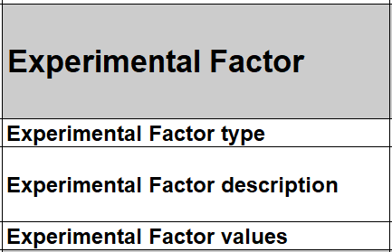
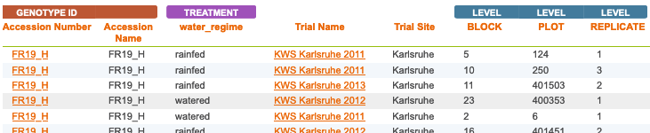
MIAPPE main sections – Experimental Factor
A treatment is a biotic or abiotic experimental factor, the effects of which are being ascertained in the study. It should take different values among the various observation units of the study.
Metadata include a name, a description and a value of the treatment
Example: MAIZE [1]
Two experimental factors/treatments: Rainfed, Watered
Block organisation

Slide 24
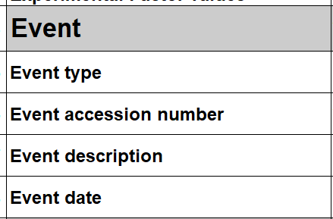
MIAPPE main sections – Event
An event is discrete occurrence at a particular time in the experiment (which can be natural, such as rain, or unnatural, such as planting, watering, etc). Can be applied at the whole study level or at the observation unit level but in the latter case, it is not the factor being studied but an additional information on the course of the experiment (e.g. unwanted pathogen attack).
Metadata include a name, a description and a time/date
Examples: POPLAR [2]
the field establishment date, 2003
the orchard was subjected to 15mm of rain on March 15, 2012 (fiction)
Study | Event
 | Name | Description | Date
Monclus et al., 2012 | Rain | 15mm of rain on the orchard | 2012-03-15

Slide 25
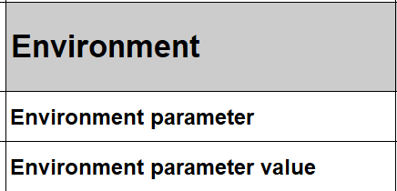
MIAPPE main sections – Environment
Environment: Environmental parameters and other experimental conditions that are controlled throughout the study and that are not a direct subject/factor of the experimentation. If the environmental variables are measured (recorded), they are described in the observed variable section.
Metadata include the description and the value of the environmental variable
Example:
Environment parameter | Environment parameter Value
Air temperature | 22°C
Rooting medium composition | Ca (XEO:00058): 5 mg/L; ...

Slide 26
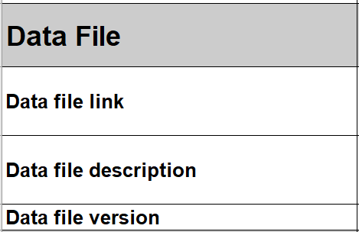
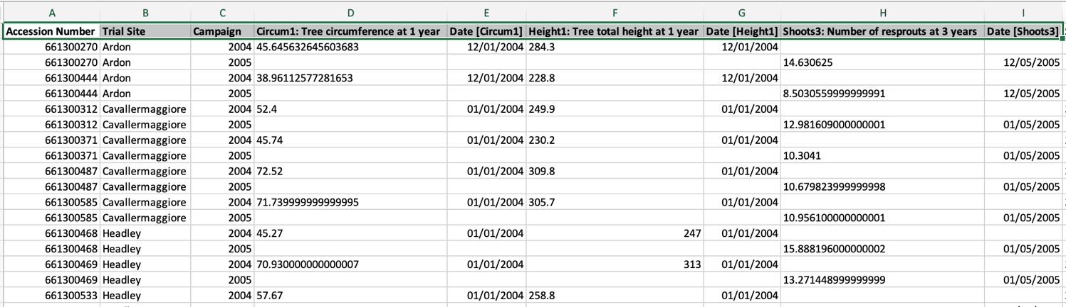
MIAPPE V1.1 Overview – Data file
Any format (Data matrix, NIRS, Images, ….)
Mostly tabular
Metadata on each column header

Slide 27
Crop ontology

Slide 28


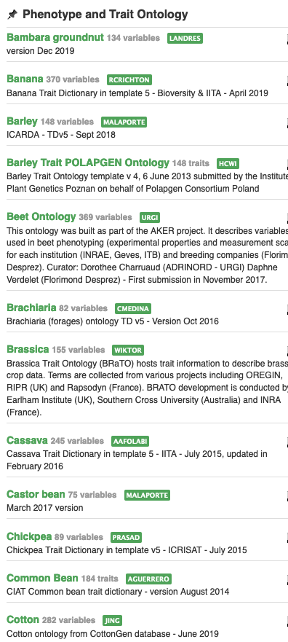
Context
Need
Importance of controlled vocabularies and ontologies for data annotation and FAIRness
Must respect crop specificities
Answer
Development of a standard to build ontologies to annotate phenotypes: “Crop Ontology”
Crop-specific vocabulary established by its community
31 ontologies crop-specific available (including woody plants): www.cropontology.org
Study | Genotype | CIR | HT | SUR
Domaine de Valcros | 6579 | 600 | 17 | 1
Domaine de Valcros | 6580 | 482 | 14 | 1
Study | Genotype | H | CIR
La Nerthe | 6579 | 23 | 650
La Nerthe | 6580 | 28 | 514

Slide 29
Standard model
Variable = trait + method + scale
The phenotypic observation
Trial | Genotype | CIR | HT | SUR
Domaine de Valcros | 6579 | 600 | 17 | 1
Domaine de Valcros | 6580 | 482 | 14 | 1
Variable | Variable ID
 | Variable name
 | Variable synonyms
 | Context of use
 | Growth stage
 | Variable status
 | Variable Xref
 | Institution
 | Scientist
 | Date
 | Language
 | Crop

Slide 30
Standard model
Variable = trait + method + scale
What is the studied character?
Trial | Genotype | CIR | HT | SUR
Domaine de Valcros | 6579 | 600 | 17 | 1
Domaine de Valcros | 6580 | 482 | 14 | 1
Trait | Trait ID
 | Trait
 | Trait class
 | Trait description
 | Trait synonyms
 | Main trait abbreviation
 | Alternative trait abbreviations
 | Entity
 | Attribute
 | Trait status
 | Trait Xref
Circumference of the tree
Total height of the tree
Survival state of the tree

Slide 31
Standard model
Variable = trait + method + scale
How is it observed?
Trial | Genotype | CIR | HT | SUR
Domaine de Valcros | 6579 | 600 | 17 | 1
Domaine de Valcros | 6580 | 482 | 14 | 1
Method | Method ID
 | Method
 | Method class
 | Method description
 | Formula
 | Method reference
Measured at breast height with a graduated ribbon
Measured from soil to crown with a pole or a clinometer
Visual assessment with a reference scoring scale

Slide 32
Standard model
Variable = trait + method + scale
How is it expressed (unit or scale)?
Trial | Genotype | CIR | HT | SUR
Domaine de Valcros | 6579 | 600 | 17 | 1
Domaine de Valcros | 6580 | 482 | 14 | 1
Scale | Scale ID
 | Scale name
 | Scale class
 | Decimal places
 | Lower limit
 | Upper limit
 | Scale Xref
 | Category 1
 | Category 2
 | …
 | Category n
cm
mm
0 = Alive
1 = Dead
2 = Doubtful

Slide 33
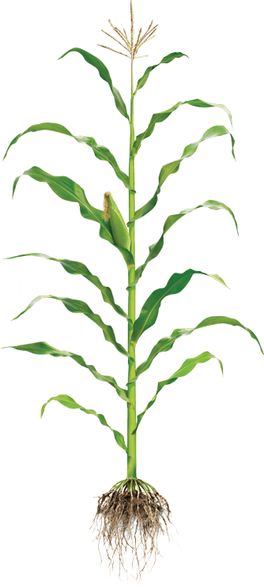
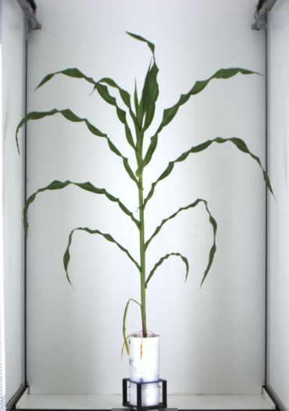

Controlled Vocabulary Challenge
Phenotyping/environment variable = Trait + Method + Unit/Scale
+
+
Trait
Method
Unit
M1: Total height
M2: First tassel branch
M3: Last expanded leaf
M4: Youngest growing leaf
U1: cm
U2: mm
We need Species specific CV/Ontologies
BUT
Near infinite number of combination
T1: Plant Height
M5: Highest pixel corresponding to plant
U3: pixel
L Cabrera

Slide 34
Controlled Vocabulary Challenge
Variable annotation
Using MIAPPE for minimal variable description
Optional reference to existing crop ontology
Ad hoc Trait or Method or Scale in MIAPPE dataset
Focus on Trait for interoperability

Slide 35
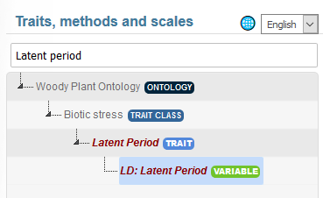
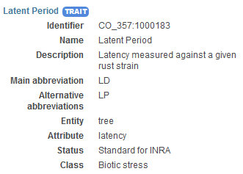
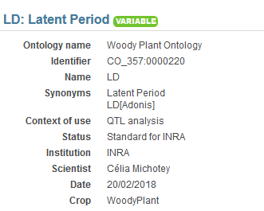
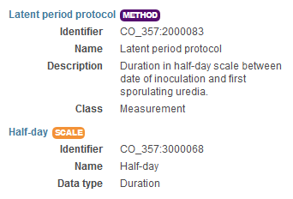
Controlled Vocabulary Challenge
Variable annotation Example 1
Trait | Trait description
L98AR1 | Latent Period for strain 98AR1
L93CV1 | Latent Period for strain 93CV1
Canker_LL | Canker lesion length

Slide 36
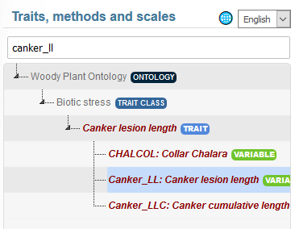
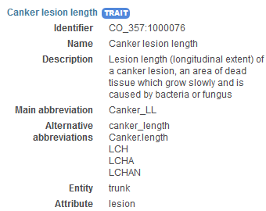
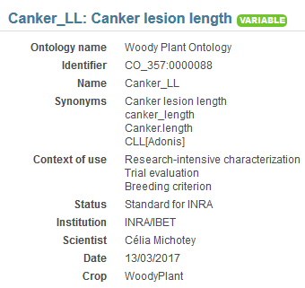
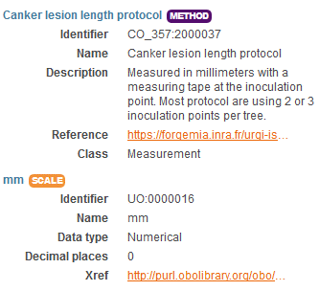

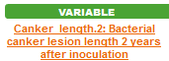
Controlled Vocabulary Challenge
Variable annotation Example 2
Trait | Trait description
L98AR1 | Latent Period for strain 98AR1
L93CV1 | Latent Period for strain 93CV1
Canker_LL | Canker lesion length
36

Slide 37
Controlled Vocabulary Challenge
Trait decomposition to Entity/Attribute
Trait = Leaf Area ➔ Entity = Leaf, Attribute = Area
Enables ad hoc controlled vocabulary + Trait Interoperability
Formalized by Mungal et al 2009
Existing in crop ontology
EMPHASIS proposition : Use for easy Variable creation and interoperability

Slide 38
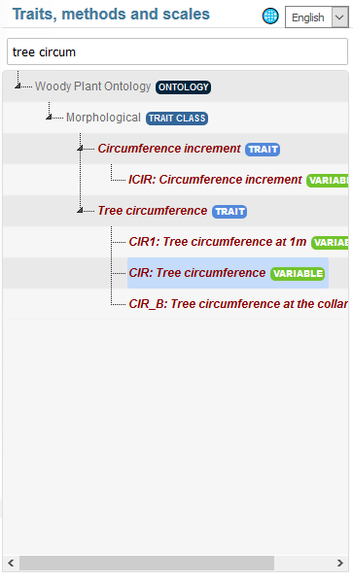
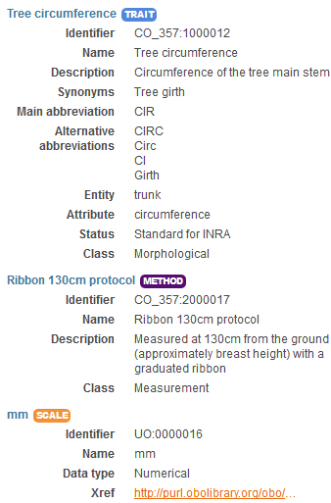
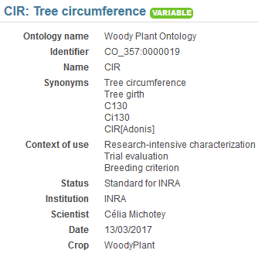
Tree Variable example1 https://urgi.versailles.inra.fr/ontologyportal#termIdentifier=CO_357:0000019
1 Trait
3 Variables
3 methods

Slide 39
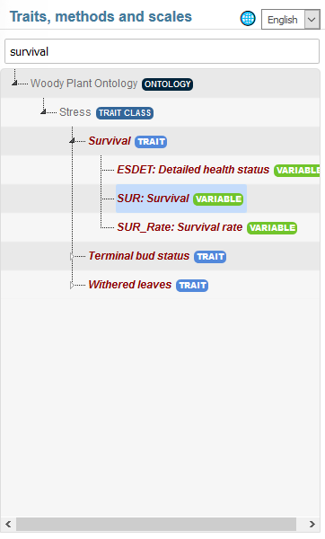
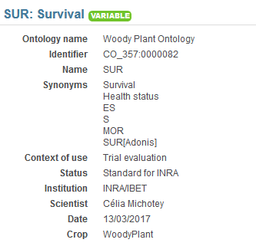
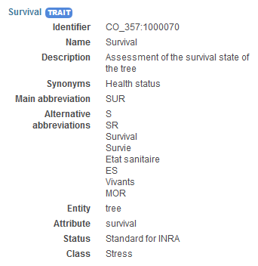
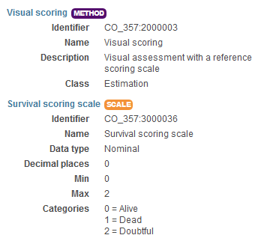
Tree Variable example2 https://urgi.versailles.inra.fr/ontologyportal#termIdentifier=CO_357:0000082

Slide 40
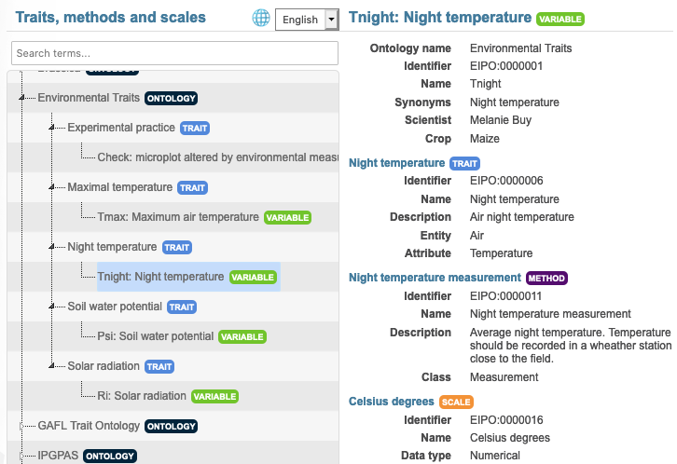
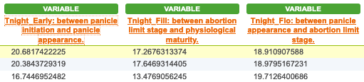
Environnemental Variable example
Variable annotation

Slide 41
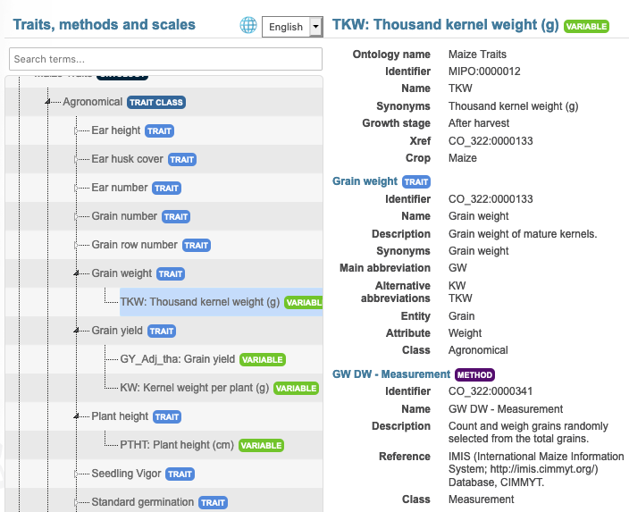

Crop Variable example
Ad Hoc Variable
Trait: reference Crop Ontology Maize

Slide 42
Phenology handling, the woOdy plant ontology example

Slide 43
BBCH scale, Woody Plant ontology example
Scale used to identify the phenological development stages of plants
Bud development
Leaf development
Stem development and elongation
Flowering
Fruit development
Senescence
Uses a decimal code system, which is divided into principal and secondary growth stages
Woody BBCH
Development of a BBCH scale for Forest Plants by the project TEMPO (French network of observatories dedicated to phenology for the entire living kingdom) => homogenize variables and facilitate data links
BBCH-scale available in the Woody Plant Ontology

Slide 44
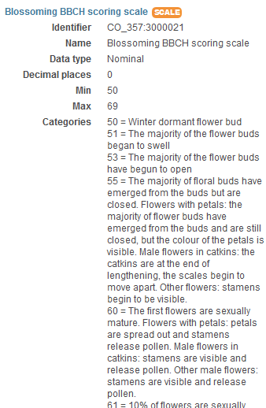
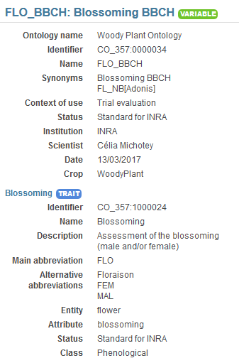
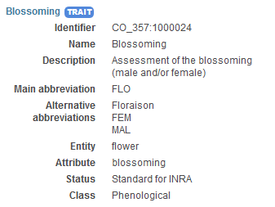
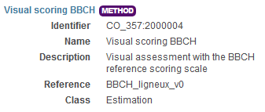
BBCH scale, Woody Plant ontology example

Slide 45








Crop Ontology repositories and workflow
Repository, some crop ontologies
Version History
Repository, some other crop ontologies
Search over several ontologies
Trait Dictionary Template v5
Plant scientist friendly browser
https://urgi.versailles.inra.fr/ontologyportal

Slide 46
HANDS ON

Slide 47
Annotation MIAPPE
Fichiers
Phenotyping data
Idéalement votre jeux de données
Test dataset: POP2_dataset.xlsx
MIAPPE template
https://tinyurl.com/miappe-2023-1
https://github.com/MIAPPE/MIAPPE/tree/master/MIAPPE_Checklist-Data-Model-v1.1
MIAPPE_Checklist-Data-Model-v1.1.xlsx
MIAPPEv1.1_training_spreadsheet.xlsx
CropOntology
http://www.cropontology.org
TODO
Describe the dataset using MIAPPE v1.1 template

Slide 48
Variables Hands On

Slide 49
Fill TDv5 for the following variables
AGM
The Above-ground matter of the plants have been harvested for a whole plot, dried out then weighted. The result has been expressed in grams by square meters and tons by hectares
Same measure as above but at anthesis rather than harvest.
Same but express the developmental stage using zadock (optional)
Grain Yield
The grain were harvested then weighted at 0% and 15% humidity. The result where expressed in q/ha and grams per square metters
Disease
Septoria was inoculated, the inoculation date being recorded as julian date, day of year and degree days. The Septoria score was evaluated on two leaves, with a 1 (Resistant) to 9 (Susceptible) notation scale. Agent: Mycosphaerella graminicola (Septoria tritici). Symptoms: the lesions are linear and restricted laterally. The following methods were used for measurement: Saari and Prescott, 1975; Eyal et al., 1987; Duveiller et al., 2012.

Slide 50
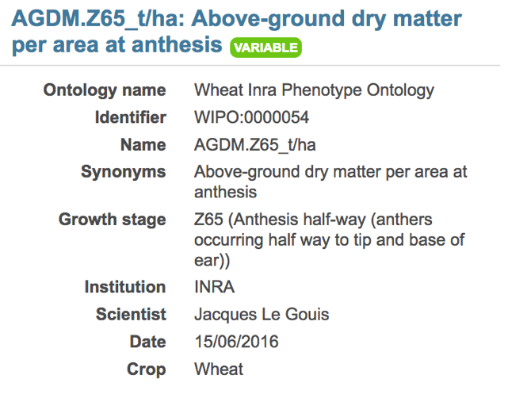
Wheat Variable exemple : Variable
Variable ID | Variable name | Variable synonyms | Context of use | Growth stage | Variable status | Variable Xref | Institution | Scientist | Date | Language | Crop
WIPO:0000054 | AGDM.Z65_t/ha | Above-ground dry matter per area at anthesis |  | Z65 (Anthesis half-way (anthers occurring half way to tip and base of ear)) |  |  | INRA | Jacques Le Gouis | 15/06/2016 | EN | Wheat

Slide 51
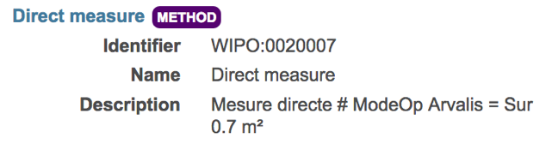
Wheat Variable exemple : Variable
Method ID | Method name | Method class | Method description | Formula | Method reference
WIPO:0020007 | Direct measure |  | Mesure directe # ModeOp Arvalis = Sur 0.7 m² |  | PDF URL + PAGE

Slide 52
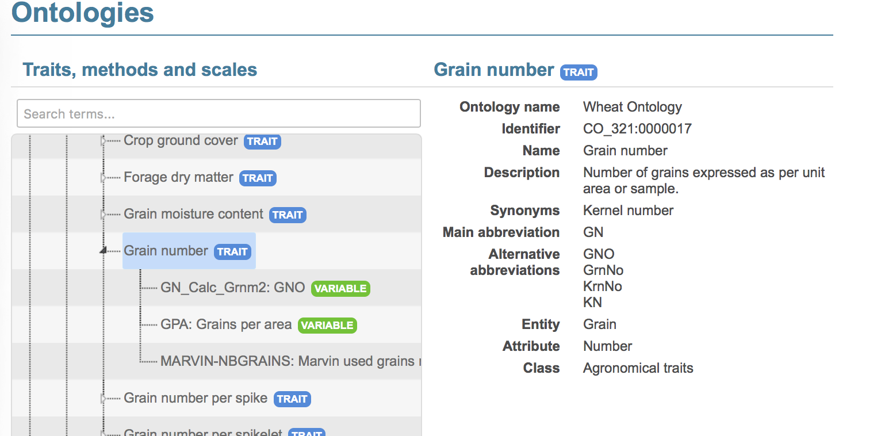
One Trait with multiple variables

Slide 53
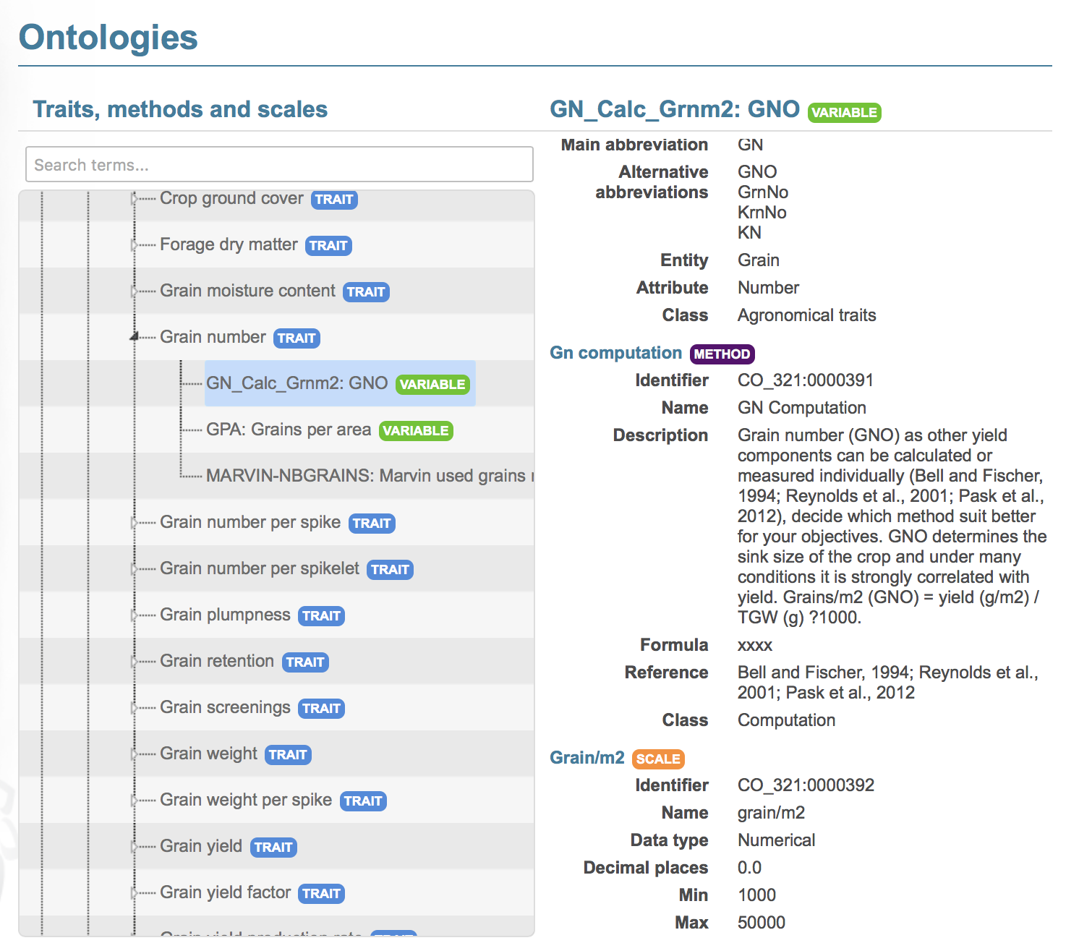
One Trait with multiple variables

Slide 54
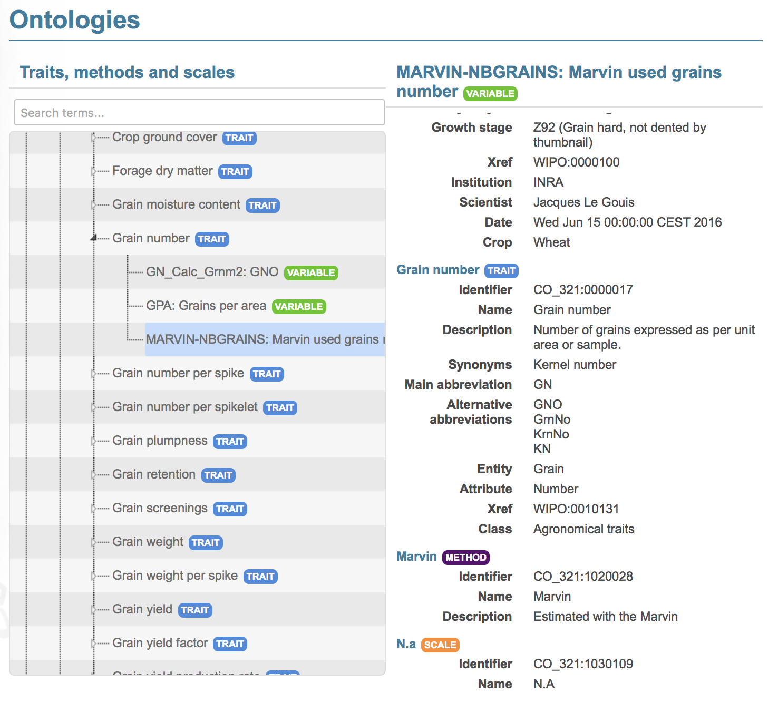
One Trait with multiple variables

Slide 55
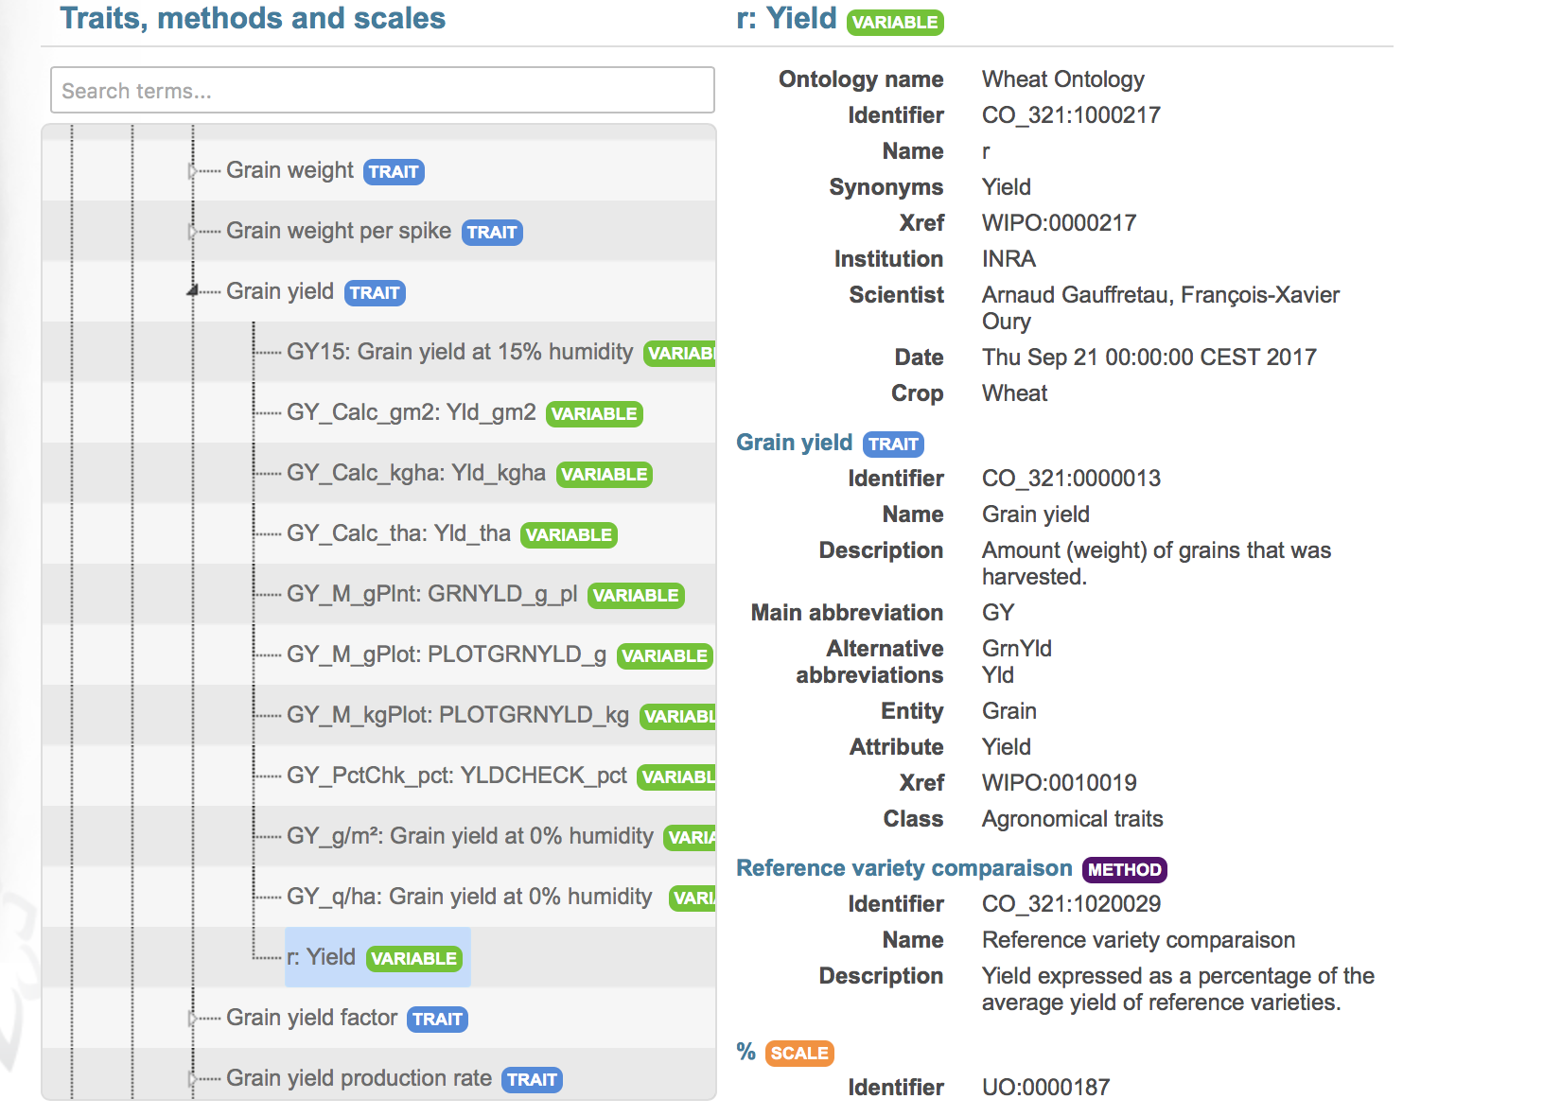
Yield: many variables

Slide 56

Variable by stage Combination
Usefull for genetic analysis but:
Number of variable combination explosion
Poor data reusability
Recommandation: One variable for the trait and one for the phenology. Then combine depending on your scientific question

Slide 57
Hands On
How many variables from the following description :
In the popyomics study of the populus canker lesion impact, the trees where inoculated with strains 98AR1 and 93CV1. The lesion lenght, ie the impact of the inoculation, was measured one and two years after inoculation.

